Slide 1



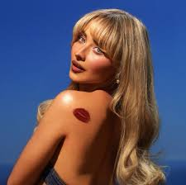
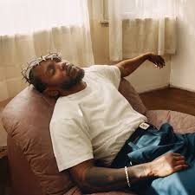





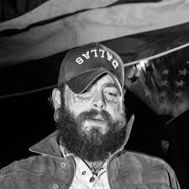
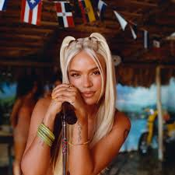

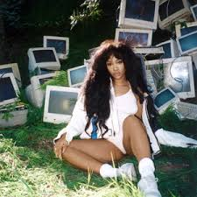


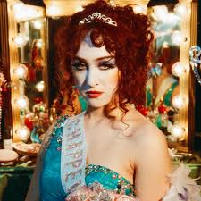

Team 9
Spotify Data Analysis
Start Presentation
Data Analytics Boot Camp

Slide 2


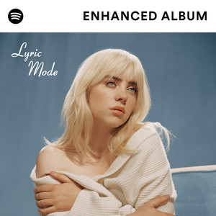

Log in
Chloe K.
Playlist
Our Team
Objective
Playlist
Background
SWOT Analysis
Introduction
Objective
What is Spotify?
SWOT Analysis
Music Genres Analysis
Artist Popularity
Song Popularity
Conclusion
Our Analysis
Conclusion
Q&A
Thank You!
Play
Follow

Slide 3
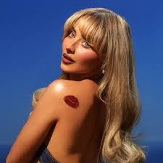
Log in
Team 9
Playlist
Our Team
Objective
Team 9
Background
SWOT Analysis
Our Analysis
Conclusion
Q&A
Thank You!
Chloe
King
Emeka
Osasah
Annie
OuYang
Jimmy
Lee
Jorge
Martinez

Slide 4





Log in
Emeka O.
Playlist
Our Team
Objective
Objective
Background
SWOT Analysis
The objective of this project is to analyze Spotify's data to discover trends and patterns with the aim of developing valuable insights from our findings, and then, make data driven recommendations.
The dataset includes 1 Million songs
Date range from 2000 to 2023
Total of 61,445 unique artists and 82 genres
Our Analysis
Conclusion
Q&A
Thank You!

Slide 5

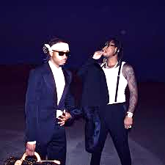


Log in
Annie O.
Playlist
Our Team
Objective
Introduction
Background
SWOT Analysis
Spotify was launched in 2008 by Swedish entrepreneurs Daniel Ek and Martin Lorentzon
Purpose: Combat music piracy and provide a legal alternative to illegal downloads
Business Model: Freemium model offering free ad-supported streaming or premium ad-free subscription
Impact: Revolutionized the music industry and rapidly grew its user base
Our Analysis
Conclusion
Q&A
Thank You!

Slide 6
Log in
Jimmy L.
Playlist
Our Team
Objective
Current Statistics
Background
SWOT Analysis
Our Analysis
Conclusion
626m
246m
100m
Q&A
Thank You!
Active Users
Premium Subscribers
Total Tracks
Achieved
Achieved
Achieved

Slide 7
Log in
Jimmy L.
Playlist
Our Team
Objective
Current Statistics
Background
SWOT Analysis
Our Analysis
Conclusion
6m
180+
31%
Q&A
Thank You!
Podcasts
Global Markets Reached
Of the Overall Streaming Market
Achieved
Achieved
Achieved

Slide 8




Log in
Jorge M.
Playlist
Our Team
Objective
Competition
Background
SWOT Analysis
Our Analysis
Conclusion
Q&A
Thank You!
Apple
Music
Amazon
Music
YouTube
Music
TIDAL
Music

Slide 9


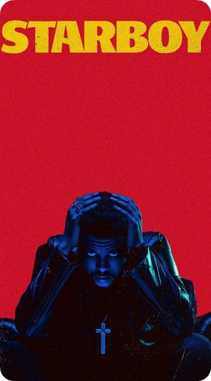
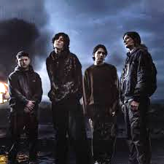

Log in
Emeka O.
Playlist
Our Team
Objective
Strengths
Background
SWOT Analysis
Extensive music library
Market leadership
Personalized playlists
Our Analysis
Conclusion
Weaknesses
Q&A
Thank You!
Competitor bundling
High dependency on record labels
Low profit margins

Slide 10



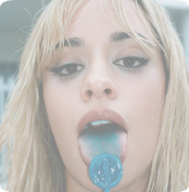

Log in
Emeka O.
Playlist
Our Team
Objective
Opportunities
Background
SWOT Analysis
Vertical integration
Innovative technologies and AI
Emerging markets
Our Analysis
Conclusion
Threats
Q&A
Thank You!
Intense competition
Economic downturns
Regulatory challenges

Slide 11
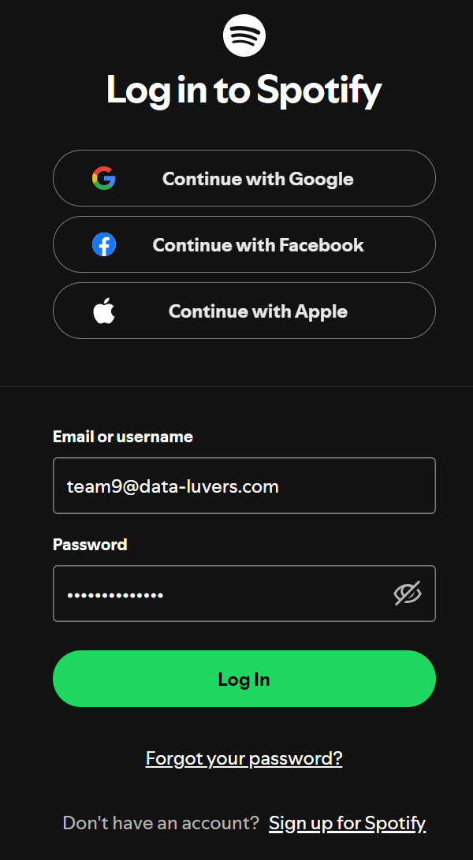
Playlist
Our Team
Objective
Background
SWOT Analysis
Our Analysis
Conclusion
Q&A
Thank You!

Slide 12
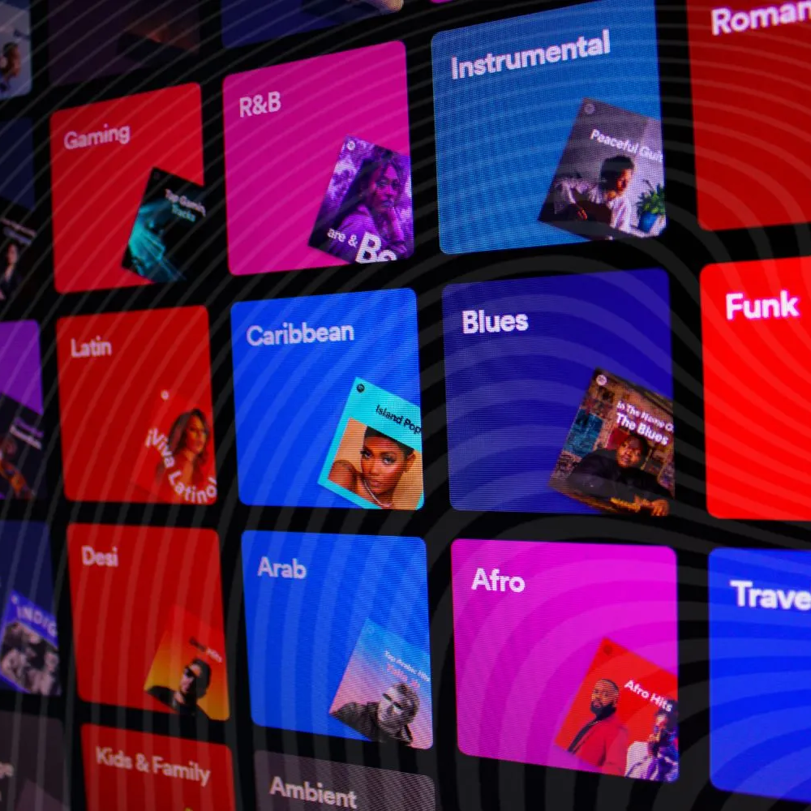


Log out
Jorge M.
Playlist
Our Team
Analysis
Objective
Music Genres
Background
SWOT Analysis
Our Analysis
Top 10 Genres by Popularity (All Time)
Top 10 Trending Genres (2023)
Conclusion
Q&A
Thank You!
Genre Information
This dataset contains 82 genres revealing insights to the music landscape. Genres like pop, hip-hop, and rock consistently dominate the charts, reflecting their widespread appeal and cultural significance.

Slide 13
Log out
Jorge M.
Playlist
Our Team
Analysis
Objective
Music Genres
Background
SWOT Analysis
Top 10 Genres by Popularity (All Time)
Pop
Our Analysis
Hip-Hop
Conclusion
Rock
Dance
Q&A
Metal
Genre
Placeholder for Charts
Thank You!
Alt-Rock
Sad
Indie-Pop
Folk
Country
0 10 20 30 40 50
Average Popularity

Slide 14
Log out
Jorge M.
Playlist
Our Team
Analysis
Objective
Music Genres
Background
SWOT Analysis
Top 10 Trending Genres (2023)
Detroit Techno
Our Analysis
Heavy Metal
Conclusion
Chicago House
Breakbeat
Q&A
Show Tunes
Genre
Placeholder for Charts
Thank You!
Grindcore
Afrobeat
Power Pop
Drum & Bass
Romance
0 2 4 6 8
Popularity Change from 2022 to 2023

Slide 15


Log out
Jimmy L.
Playlist
Our Team
Analysis
Objective
Music Genres
Background
SWOT Analysis
Our Analysis
Top 10 Genres with the Most Danceability (2023)
Top 10 Danceability Songs by Artist & Genre (2023)
Danceability Changes from 2000-2023
Conclusion
Q&A
Thank You!
What is “Danceability”?
Danceability is the measure of how suitable the track is for dancing based on a combination of musical elements like tempo, rhythm stability, beat strength, and overall regularity (0-1 scale).

Slide 16
Log out
Jimmy L.
Playlist
Our Team
Analysis
Objective
Music Genres
Background
SWOT Analysis
Top 10 Genres with the Most Danceability (2023)
0.8
0.7
Our Analysis
0.6
Conclusion
0.5
Q&A
0.4
Danceability
Thank You!
0.3
0.2
0.1
0.0
Chicago House
Hip-Hop
Disco
Deep House
Minimal Techno
Funk
Dancehall
Detroit Techno
Breakbeat
Groove
Genre

Slide 17
Log out
Jimmy L.
Playlist
Our Team
Analysis
Objective
Music Genres
Background
SWOT Analysis
Top 10 Danceability Songs by Artist & Genre (2023)
Mishelle Master Boys – Pal Party (Salsa)
Our Analysis
Group X – It is Saim (Comedy)
Conclusion
MC Menor MT – Sarra na Ponta da […] (Funk)
Mc Rd – Cavucando (Funk)
Q&A
Timbaland – Give It To Me (Dance)
Artist – Song - Genre
Thank You!
Mc Delux – Pra Fumar um Rosh (Funk)
Mc Delux – Festa no Guaruja (Funk)
U-Brown – Soldier of Jah Army (Dancehall)
Lewis OfMan – Attitude Clubz Remix (French)
Armand Van Helden- Ride It (Deep House)
0.0 0.2 0.4 0.6 0.8 1.0
Danceability

Slide 18
Log out
Jimmy L.
Playlist
Our Team
Analysis
Objective
Music Genres
Background
SWOT Analysis
Danceability Changes from 2000 to 2023
Our Analysis
0.550
Conclusion
0.545
Q&A
0.540
Danceability
Thank You!
0.535
0.530
0.525
2000
2005
2010
2015
2020
Year

Slide 19
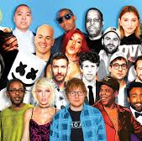
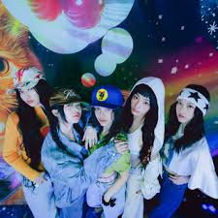
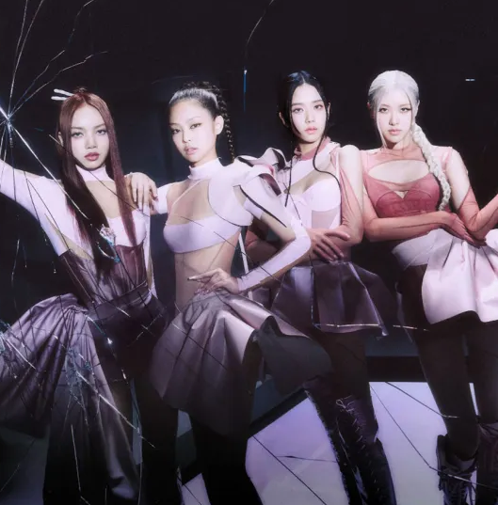
Log out
Annie O.
Playlist
Our Team
Analysis
Objective
Artist Popularity
Background
SWOT Analysis
Our Analysis
Top 3 Artists by Popularity for the Top 10 Genres
Tempo vs. Danceability (2023)
Danceability vs. Popularity (2023)
Conclusion
Q&A
Thank You!
What determines “Popularity”?
Elements like tempo and danceability play a significant role in determining popularity; songs with upbeat tempos and high danceability tend to attract more listeners and keep them engaged.

Slide 20
Log out
Annie O.
Playlist
Our Team
Analysis
Objective
Artist Popularity
Background
SWOT Analysis
Genre | Artist | Popularity | Danceability | Tempo | Genre | Artist | Popularity | Danceability | Tempo
Chill | Prinz | 75.00 | 0.84 | 142.09 | Hip-Hop | Bizarrap | 96.00 | 0.78 | 122.10
Chill | CORBAL | 71.00 | 0.72 | 80.28 | Hip-Hop | Cartel De Santa | 80.00 | 0.87 | 87.97
Chill | Victoria Monét | 71.00 | 0.73 | 76.96 | Hip-Hop | NF | 80.00 | 0.62 | 90.42
Country | Zach Bryan | 79.00 | 0.45 | 122.81 | House | Anne-Marie | 64.00 | 0.71 | 140.08
Country | Morgan Wallen | 77.33 | 0.54 | 122.23 | House | MELON | 61.20 | 0.66 | 129.39
Country | Luke Combs | 75.00 | 0.51 | 111.15 | House | Mark Mendy | 60.00 | 0.72 | 125.04
EDM | Lucas & Steve | 68.00 | 0.71 | 125.06 | Indie-Pop | beabadoobee | 82.00 | 0.62 | 113.95
EDM | Sigala | 68.00 | 0.68 | 125.02 | Indie-Pop | Lovejoy | 75.00 | 0.52 | 152.01
EDM | Chico Rose | 66.00 | 0.55 | 121.15 | Indie-Pop | Måneskin | 68.92 | 0.54 | 130.36
Electro | Melanie Martinez | 75.00 | 0.39 | 181.87 | Metal | Linkin Park | 84.00 | 0.60 | 105.01
Electro | Miranda! | 75.00 | 0.77 | 122.92 | Metal | Falling In Reverse | 80.00 | 0.40 | 161.95
Electro | Young Marco | 69.00 | 0.69 | 136.02 | Metal | SiM | 74.00 | 0.27 | 159.89
French | GAULOIS | 74.00 | 0.72 | 134.07 | Pop | TINI | 84.00 | 0.91 | 119.87
French | Trinix | 69.00 | 0.72 | 112.52 | Pop | Miley Cyrus | 80.27 | 0.59 | 130.60
French | Hös Copperfield | 68.00 | 0.75 | 106.53 | Pop | SZA | 80.00 | 0.68 | 99.94
Our Analysis
Conclusion
Q&A
Thank You!

Slide 21
Log out
Annie O.
Playlist
Our Team
Analysis
Objective
Artist Popularity
Background
SWOT Analysis
Tempo vs. Popularity (2023)
95
0.9
Our Analysis
90
0.8
Conclusion
85
0.7
Q&A
80
Popularity
Danceability
0.6
Thank You!
75
70
0.5
65
0.4
60
0.3
80
100
120
140
160
180
Tempo

Slide 22
Log out
Annie O.
Playlist
Our Team
Analysis
Objective
Artist Popularity
Background
SWOT Analysis
Danceability vs. Popularity (2023)
95
180
Our Analysis
90
160
Conclusion
85
Q&A
80
140
Popularity
Tempo
Thank You!
75
120
70
100
65
60
80
0.3
0.4
0.5
0.6
0.7
0.8
0.9
Danceability

Slide 23
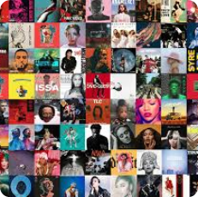

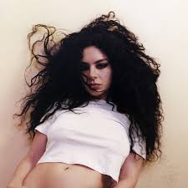
Log out
Chloe K.
Playlist
Our Team
Analysis
Objective
Song Popularity
Background
SWOT Analysis
Our Analysis
Top 10 Songs from 2000 to 2023
Top 3 Songs for Top 10 Genres from 2000 to 2023
Top 10 Songs (2023)
Top 3 Songs for Top 10 Genres (2023)
Conclusion
Q&A
Thank You!
What is “Popularity”?
In this case, popularity is a comparative measure. It is a score from 0-100 that ranks how popular an artist/track is compared to other artists/tracks. This score is determined by a complex algorithm that considers many factors, including total streams, recent plays, and more.

Slide 24
Log out
Chloe K.
Playlist
Our Team
Analysis
Objective
Song Popularity
Background
SWOT Analysis
Top 10 Songs of All Time from 2000-2023
Artist | Song | Genre | Popularity
Miley Cyrus | Flowers | Pop | 100
Bizarrap | Shakira: Bzrp Music Sessions, Vol. 53 | Hip-Hop | 96
The Weeknd | Die For You - Remix | Pop | 95
SZA | Kill Bill | Pop | 94
Manuel Turizo | La Bachata | Pop | 93
David Guetta | I'm Good (Blue) | Dance | 93
Rema | Calm Down (with Selena Gomez) | Pop | 93
NewJeans | OMG | K-Pop | 92
Bizarrap | Quevedo: Bzrp Music Sessions, Vol. 52 | Hip-Hop | 92
d4vd | Here With Me | Pop | 92
Our Analysis
Conclusion
Q&A
Thank You!

Slide 25
Log out
Chloe K.
Playlist
Our Team
Analysis
Objective
Song Popularity
Background
SWOT Analysis
Top 3 Songs for Top 10 Genres from 2000 to 2023
Artist | Song | Genre | Artist | Song | Genre
Miley Cyrus | Flowers | Pop | The Neighbourhood | Softcore | Alt-Rock
The Weeknd | Die For You - Remix | Pop | The Neighbourhood | Daddy Issues | Alt-Rock
SZA | Kill Bill | Pop | The Neighbourhood | You Get Me So High | Alt-Rock
Bizarrap | Shakira: Bzrp Music Sessions, Vol. 53 | Hip-Hop | Natanael Cano | AMG | Sad
Bizarrap | Quevedo: Bzrp Music Sessions, Vol. 52 | Hip-Hop | Peso Pluma | PRC | Sad
Yandel | Yandel 150 | Hip-Hop | Carin Leon | Que Vuelvas | Sad
Imagine Dragons | Bones | rock | JVKE | golden hour | Indie-Pop
Imagine Dragons | Believer | rock | New West | Those Eyes | Indie-Pop
Elton John | Cold Heart - PNAU Remix | rock | TV Girl | Lovers Rock | Indie-Pop
David Guetta | I'm Good (Blue) | dance | Lizzy McAlpine | ceilings | Folk
Chris Brown | Under The Influence | dance | Seafret | Atlantis | Folk
RAYE | Escapism. | dance | Patrick Watson | Je te laisserai des mots | Folk
Linkin Park | Numb | Metal | Morgan Wallen | Last Night | Country
Linkin Park | Lost | Metal | Zach Bryan | Something in the Orange | Country
System Of A Down | Chop Suey! | Metal | Morgan Wallen | Ain’t That Some | Country
Our Analysis
Conclusion
Q&A
Thank You!

Slide 26
Log out
Chloe K.
Playlist
Our Team
Analysis
Objective
Song Popularity
Background
SWOT Analysis
Top 10 Songs (2023)
Artist | Song | Popularity | Genre
Miley Cyrus | Flowers | 100 | Pop
Bizarrap | Shakira: Bzrp Music Sessions, Vol. 53 | 96 | Hip-Hop
The Weeknd | Die For You - Remix | 95 | Pop
NewJeans | OMG | 92 | K-Pop
Peso Pluma | PRC | 90 | Sad
Gorillaz | Tormenta (feat. Bad Bunny) | 89 | Hip-Hop
Morgan Wallen | Last Night | 88 | Country
j-hope | on the street (with J. Cole) | 88 | K-Pop
The Kid LAROI | Love Again | 87 | Hip-Hop
Cartel De Santa | Shorty Party | 87 | Hip-Hop
Our Analysis
Conclusion
Q&A
Thank You!

Slide 27
Log out
Chloe K.
Playlist
Our Team
Analysis
Objective
Song Popularity
Background
SWOT Analysis
Top 10 Songs (2023)
Artist | Song | Popularity | Genre
Miley Cyrus | Flowers | 100 | Pop
Bizarrap | Shakira: Bzrp Music Sessions, Vol. 53 | 96 | Hip-Hop
The Weeknd | Die For You - Remix | 95 | Pop
NewJeans | OMG | 92 | K-Pop
Peso Pluma | PRC | 90 | Sad
Gorillaz | Tormenta (feat. Bad Bunny) | 89 | Hip-Hop
Morgan Wallen | Last Night | 88 | Country
j-hope | on the street (with J. Cole) | 88 | K-Pop
The Kid LAROI | Love Again | 87 | Hip-Hop
Cartel De Santa | Shorty Party | 87 | Hip-Hop
Top 3 Songs for Top 10 Genres (2023)
Artist | Song | Popularity | Genre | Artist | Song | Popularity | Genre
Morgan Wallen | Last Night | 88 | County | Loreen | Tattoo | 81 | Electro
Morgan Wallen | Ain’t That Some | 82 | County | Alok | Work With My Love | 77 | Electro
Morgan Wallen | Thinkin’ Bout Me | 82 | County | Melanie Martinez | DEATH | 75 | Electro
MELON | Runaway (U & I) [Dance] | 70 | House | Linkin Park | Lost | 84 | Metal
MELON | The Rhythm of the Night (Dance) | 68 | House | Falling In Reverse | Watch The World Burn | 80 | Metal
Nathan Dawe | Oh Baby (feat. bshp & Issey Cross) | 68 | House | SiM | Under the Tree | 74 | Metal
Bizarrap | Shakira: Bzrp Music Sessions, Vol. 53 | 96 | Hip-Hop | Skrillex | Rumble | 77 | EDM
Gorillaz | Tormenta (feat. Bad Bunny) | 89 | Hip-Hop | Skrillex | RATATA | 75 | EDM
The Kid LAROI | Love Again | 87 | Hip-Hop | Fred again.. | Baby again.. | 70 | EDM
beabadoobee | Glue Song | 82 | Indie-Pop | Hamza | Nocif | 75 | French
Måneskin | BABY SAID | 77 | Indie-Pop | Zola | TOUTE LA JOURNÉE (feat. Tiakola) | 74 | French
Måneskin | GOSSIP (feat. Tom Morello) | 76 | Indie-Pop | GAULOIS | Jolie (feat. Ninho) | 74 | French
Miley Cyrus | Flowers | 100 | Pop | Prinz | Beautiful Day (Thank You for Sunshine) | 75 | Chill
The Weeknd | Die For You - Remix | 95 | Pop | GenriX | novocaine | 73 | Chill
Miley Cyrus | River | 85 | Pop | CORBAL | Hesitation | 71 | Chill
Our Analysis
Conclusion
Q&A
Thank You!

Slide 28
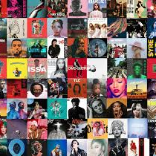

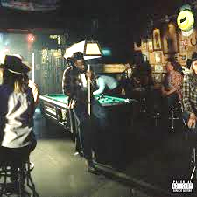
Log out
Emeka O.
Playlist
Our Team
Analysis
Objective
Song Popularity
Background
SWOT Analysis
Our Analysis
Multiple Feature Plots
Song Duration Changes from 2000-2023
Tempo Changes from 2000-2023
Tempo vs. Popularity (2023)
Loudness vs.. Energy (2023)
Acousticness vs. Popularity (2023)
Conclusion
Q&A
Thank You!
Song Analysis Information
Analyzing different features in music and how the listener interacts with these features and how these interactions help the listener navigate the Spotify app.

Slide 29
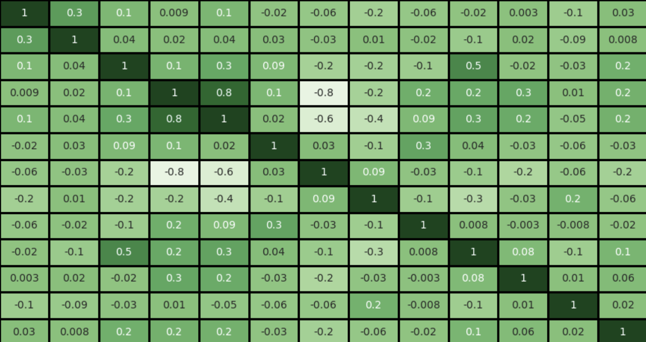
Log out
Emeka O.
Playlist
Our Team
Analysis
Objective
Song Popularity
Background
SWOT Analysis
Popularity
1.00
Year
0.75
Our Analysis
Danceability
Energy
0.5
Conclusion
Loudness
Speechiness
0.25
Q&A
Acousticness
0.00
Thank You!
Instrumentalness
Liveness
-0.25
Valence
-0.50
Tempo
Duration
-0.75
Time Signature
-1.00
Popularity
Year
Energy
Loudness
Valence
Time
Danceability
Speechiness
Liveness
Tempo
Duration
Instrumental
Acousticness

Slide 30
Log out
Emeka O.
Playlist
Our Team
Analysis
Objective
Song Popularity
Background
SWOT Analysis
Song Duration Changes from 2000 to 2023
4.4
Our Analysis
Conclusion
4.2
Q&A
Average Duration (Minutes)
Thank You!
4.0
3.8
3.6
2000
2005
2010
2015
2020
Year

Slide 31
Log out
Emeka O.
Playlist
Our Team
Analysis
Objective
Song Popularity
Background
SWOT Analysis
Tempo Changes from 2000 to 2023
122.5
Our Analysis
122.0
Conclusion
121.5
Q&A
121.0
Average Tempo (BPM)
Thank You!
120.5
120.0
119.5
119.0
2000
2005
2010
2015
2020
Year

Slide 32
Log out
Emeka O.
Playlist
Our Team
Analysis
Objective
Song Popularity
Background
SWOT Analysis
Tempo vs. Popularity (2023)
70
Our Analysis
60
Conclusion
50
Q&A
40
Popularity
Thank You!
30
20
10
0
80
100
120
120
160
180
200
220
Tempo

Slide 33
Log out
Emeka O.
Playlist
Our Team
Analysis
Objective
Song Popularity
Background
SWOT Analysis
Loudness vs. Energy (2023)
0
Our Analysis
-5
Conclusion
-10
Q&A
-15
Loudness
Thank You!
-20
-25
-30
-35
0.0
0.2
0.4
0.6
0.8
1.0
Energy

Slide 34
Log out
Emeka O.
Playlist
Our Team
Analysis
Objective
Song Popularity
Background
SWOT Analysis
Acousticness vs. Popularity (2023)
1.0
Our Analysis
0.8
Conclusion
Q&A
0.6
Acousticness
Thank You!
0.4
0.2
0.0
0
10
20
30
40
50
60
70
Popularity

Slide 35


Log out
Emeka O.
Playlist
Our Team
Objective
Conclusion
Background
SWOT Analysis
Insights:
Spotify, people, and everything in between
Mining the Insights:
Listeners gravitate towards danceable and high tempo music.
However, the listener is still open to a variety of listening options, and they are enthusiastic about upgrading their playlist.
Insights
Our Analysis
Conclusion
Q&A
Future
Thank You!

Slide 36


Log out
Emeka O.
Playlist
Our Team
Objective
Conclusion
Background
SWOT Analysis
Personalized playlist and recommendations:
Leverage song feature data to create highly tailored playlists based on listener preferences
Higher levels of algorithm generated playlists
Enhanced user experience through genre exploration:
Promote emerging genres such as lo-fi and indie-pop
Offer interactive features like “genre journeys”
Recommendation #1
Our Analysis
Conclusion
Q&A
Thank You!
Recommendation #2

Slide 37


Log out
Emeka O.
Playlist
Our Team
Objective
Conclusion
Background
SWOT Analysis
Behavior-based features:
Introduce an AI-driven feature that detects shifts in listener preferences over time and suggests updated music tastes or trends (e.g., trending artists in their favorite genres)
Improved artist and genre discovery:
Provide more visibility for emerging artists within popular genres by featuring them in curated “up-and-coming” playlists
Host exclusive content or early releases among users who favor specific genres or artists
Recommendation #3
Our Analysis
Conclusion
Q&A
Thank You!
Recommendation #4

Slide 38
Log out
Emeka O.
Playlist
Our Team
Objective
Conclusion
Background
SWOT Analysis
By implementing these strategies, Spotify can enhance the listener experience and remain aligned with evolving music trends, ultimately fostering stronger user engagement and satisfaction.
Our Analysis
Conclusion
Q&A
Recommendation #1
Recommendation #2
Recommendation #3
Recommendation #4
Thank You!

Slide 39
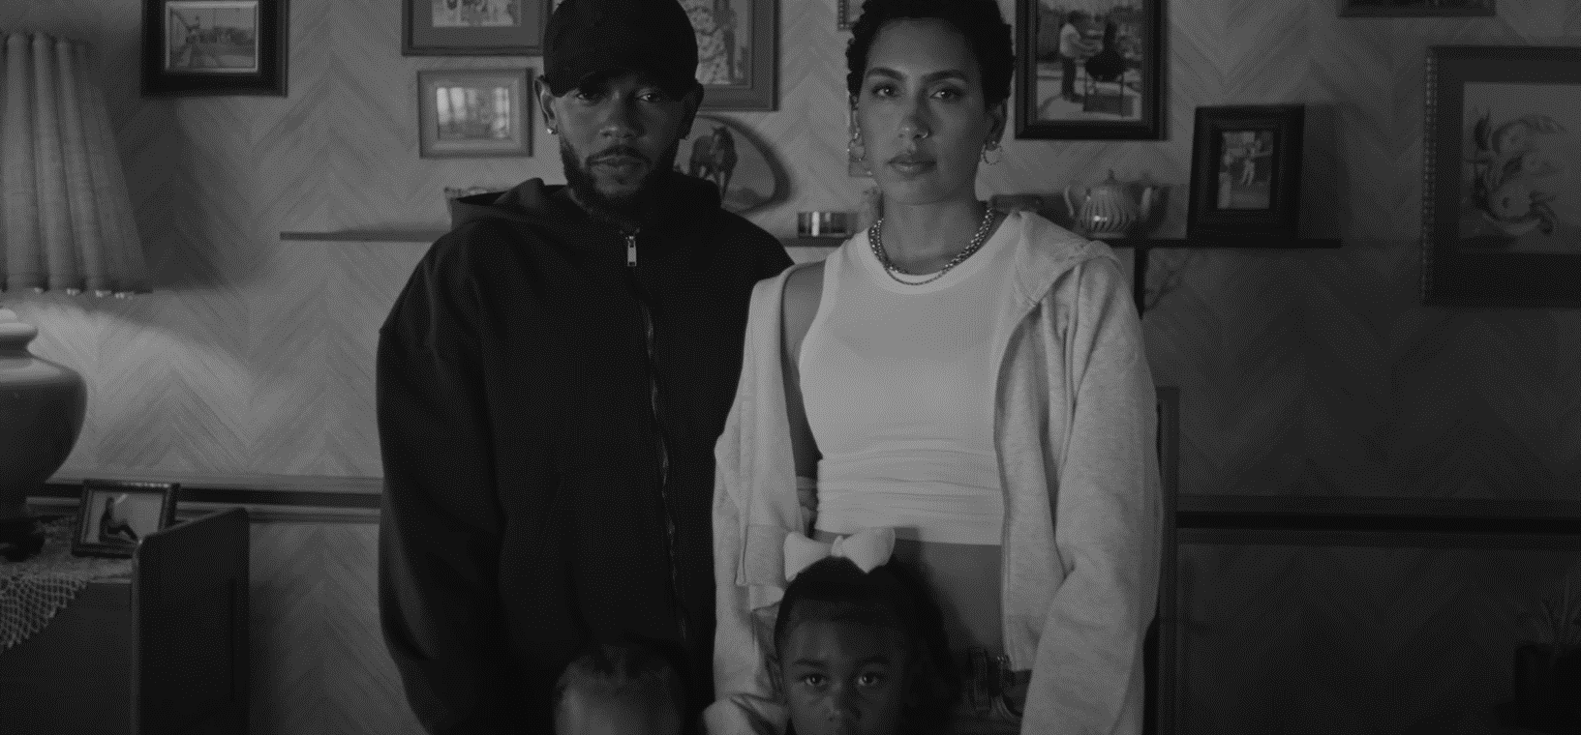
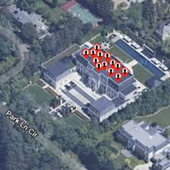

Q&A
Not Like Us
Kendrick Lamar
2:15
-2:29

Slide 40

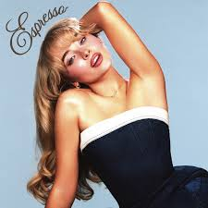
Thank You!
Espresso
Sabrina Carpenter
0:23
-2:33

